Slide 1

SAROWER AHMMED

Slide 2
What is this?
There are unit testing framework
Popular unit testing framework in market – Junit and TestNG.
The "NG" means "Next Generation".

Slide 3
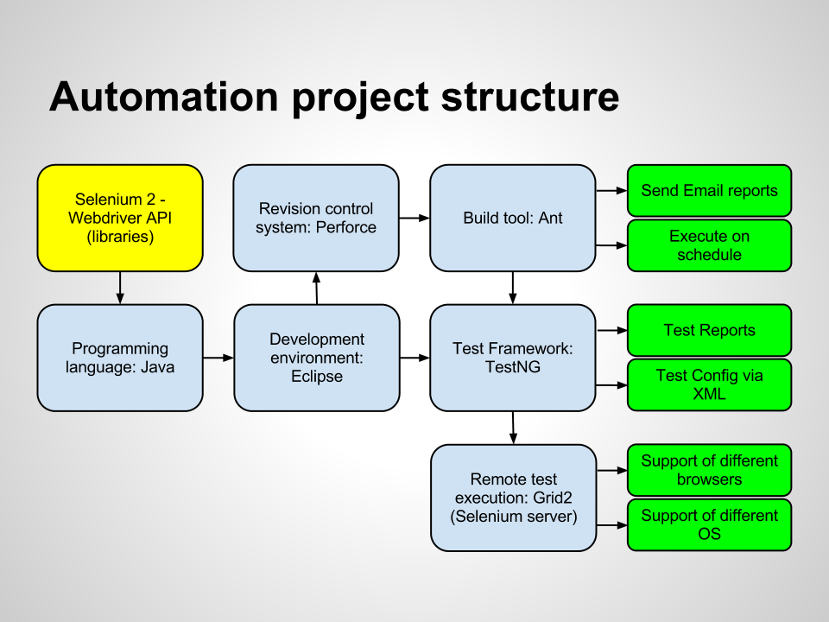
Version Control:
Git/SVN/TFS
Build Tool:
Maven/Gridle/
ANT
/ junit
Continuous Integration:
Jenkins

Slide 4
Reports- Selenium cant generate report
TestNG generates test reports in
HTML and
XML formats.
TestNG also provides a reporter API that permits third-party report generators, such as
ReportNG,
PDFngreport
TestNG-XSLT
SureFire
Extend Reporting

Slide 5
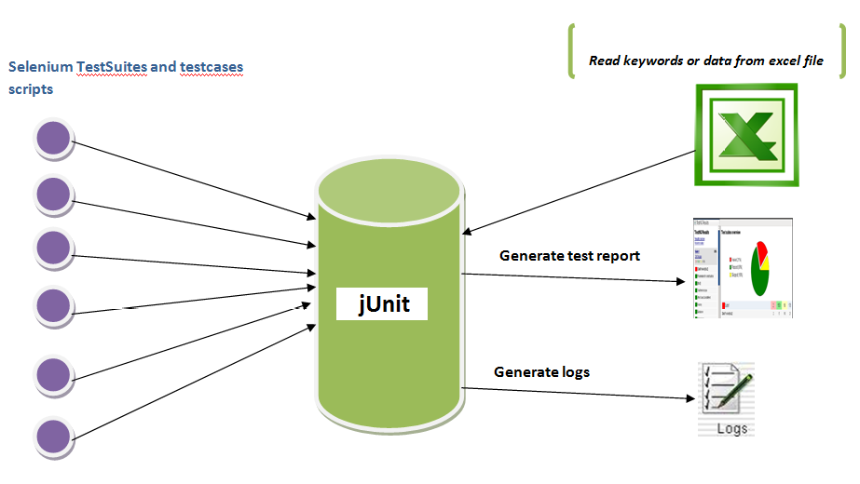

Slide 6
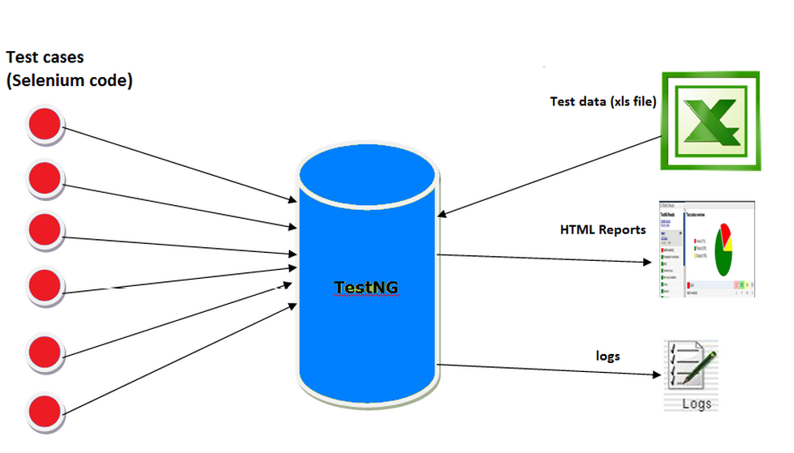

Slide 7
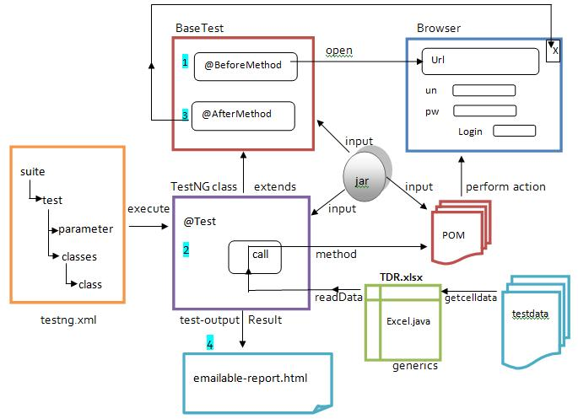

Slide 8
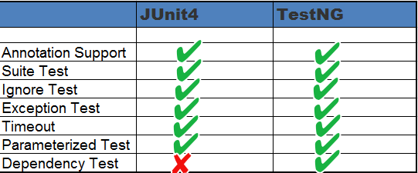
Why we need?

Slide 9
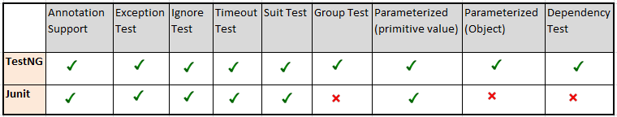
TestNG Vs Junit

Slide 10
What is annotation?
Java Annotations
Java Annotation is a tag that represents the metadata i.e. attached with class, interface, methods or fields to indicate some additional information which can be used by java compiler and JVM.

Slide 11
Built-In Java Annotations
Built-In Java Annotations used in java code
@Override
@SuppressWarnings
@Deprecated
Built-In Java Annotations used in other annotations
@Target
@Retention
@Inherited
@Documented

Slide 12
@Override
@Override annotation assures that the subclass method is overriding the parent class method. If it is not so, compile time error occurs.
Sometimes, we does the silly mistake such as spelling mistakes etc. So, it is better to mark @Override annotation that provides assurity that method is overridden.
class Animal{
void eatSomething(){
System.out.println("eating something");}
}
class Dog extends Animal{
@Override
void eatsomething(){
System.out.println("eating foods");}//should be eatSomething
}

Slide 13
Annotation in TestNG / Junit
A TestNG class is a Java class that contains at least one TestNG annotation. It is represented by the <class> tag and can contain one or more test methods. A test method is a Java method annotated by @Test in your source.
Annotations are like meta-tags that you can add to you code and apply them to methods or in class
Annotations reduces coding & extra burden from tester.
The annotations in JUnit are predefined and need not to define, you can implement it directly.

Slide 14
Description | TestNG | JUnit 4
Test annotation | @Test | @Test
Executes before the first test method is invoked in the current class | @BeforeClass | @BeforeClass
Executes after all the test methods in the current class | @AfterClass | @AfterClass
Executes before each test method | @BeforeMethod | @Before
Executes after each test method | @AfterMethod | @After
annotation to ignore a test | @Test(enbale=false) | @ignore
annotation for exception | @Test(expectedExceptions = ArithmeticException.class) | @Test(expected = ArithmeticException.class)
timeout | @Test(timeout = 1000) | @Test(timeout = 1000)
Executes before all tests in the suite | @BeforeSuite | n/a
Executes after all tests in the suite | @AfterSuite | n/a

Slide 15
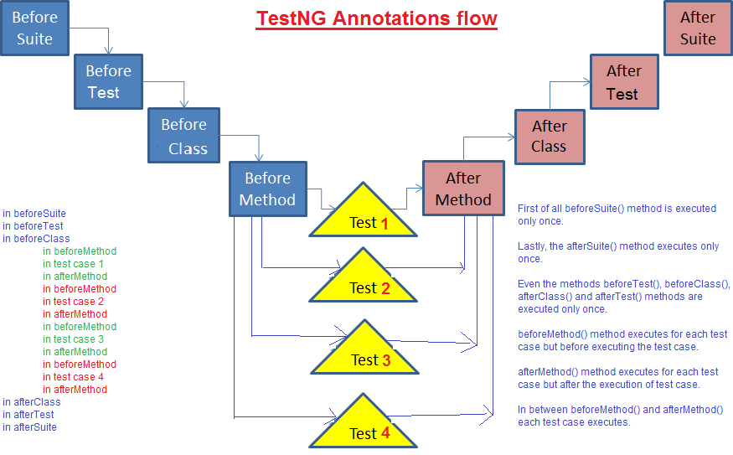

Slide 16
Annotation Which Run 1st ??
TestNg
This is BeforeSuite
This is BeforeTest
This is BeforeClass
This is BeforeMethod
This is Test
This is AfterMethod
This is AfterClass
This is AfterTest
Junit
@BeforeClass , executed before all test cases
@Before annotations ,executed before each test cases
@After ,executed after each test cases
@Before annotations ,executed before each test cases
@Test(timeout),it can be used to enforce timeout in JUnit4 test case
@After ,executed after each test cases

Slide 17
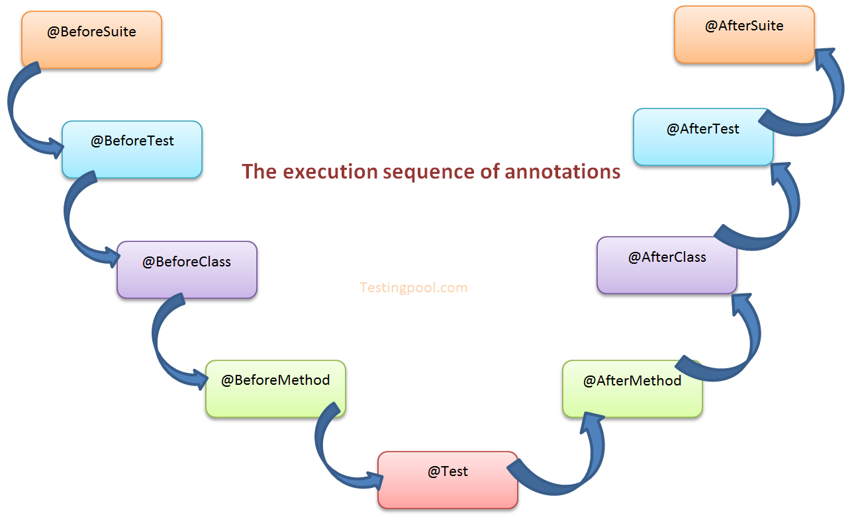

Slide 18
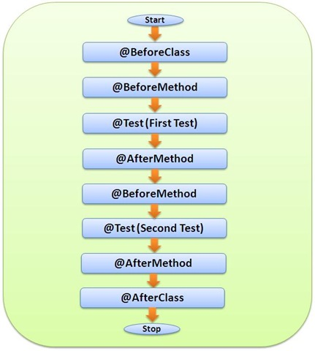

Slide 19
TestNG Annotation Meaning
Annotation | Description
@BeforeSuite | The annotated method will be run only once before all tests in this suite have run.
@AfterSuite | The annotated method will be run only once after all tests in this suite have run.
@BeforeClass | The annotated method will be run only once before the first test method in the current class is invoked.
@AfterClass | The annotated method will be run only once after all the test methods in the current class have run.

Slide 20
TestNG Annotation Meaning
@BeforeTest | The annotated method will be run before any test method belonging to the classes inside the <test> tag is run.
@AfterTest | The annotated method will be run after all the test methods belonging to the classes inside the <test> tag have run.
@BeforeGroups | The list of groups that this configuration method will run before. This method is guaranteed to run shortly before the first test method that belongs to any of these groups is invoked.
@AfterGroups | The list of groups that this configuration method will run after. This method is guaranteed to run shortly after the last test method that belongs to any of these groups is invoked.
@BeforeMethod | The annotated method will be run before each test method.
@AfterMethod | The annotated method will be run after each test method.

Slide 21
TestNG Annotation Meaning
@DataProvider | Marks a method as supplying data for a test method. The annotated method must return an Object[ ][ ], where each Object[ ] can be assigned the parameter list of the test method. The @Test method that wants to receive data from this DataProvider needs to use a dataProvider name equals to the name of this annotation.
@Factory | Marks a method as a factory that returns objects that will be used by TestNG as Test classes. The method must return Object[ ].
@Listeners | Defines listeners on a test class.
@Parameters | Describes how to pass parameters to a @Test method.
@Test | Marks a class or a method as a part of the test.

Slide 22
How to install and make 1st script
Hands On:
Please open Eclipse

Slide 23
Which test has high priority to run 1st
public class TestPriority {
@Test(priority= 3)
public void firstTest() {
System.out.println("This is First Test");
}
@Test(priority= 1)
public void secondTest() {
System.out.println("This is Second Test");
}
@Test(priority= 2)
public void thirdtest() {
System.out.println("This is Third Test");
}
}

Slide 24
public class DependsOnAnotherMethods {
@Test public void setupMethod() {
System.out.println("This is setupMethod");
Assert.assertTrue("Setup method will fail", false);;
}
@Test(dependsOnMethods = { "setupMethod" })
public void method2() {
System.out.println("This is method 2");
}
}

Slide 25
How to stop/Disable Test to run?
public class EnableOrDisableTest {
@Test(enabled=false)
public void firstTest() {
System.out.println("This is First Test");
}
@Test(enabled=true)
public void secondTest() {
System.out.println("This is Second Test");
}
@Test(enabled=false)
public void thirdtest() {
System.out.println("This is Third Test");
}
}

Slide 26
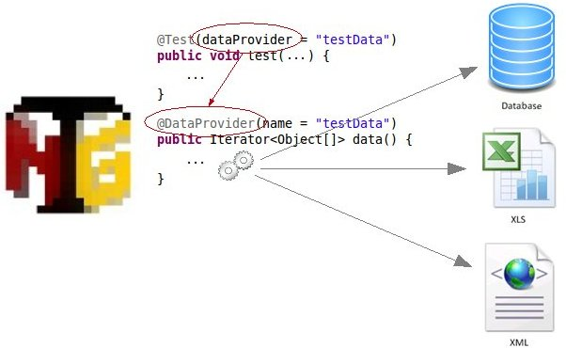

Slide 27
Benefits of Annotations
Following are some of the benefits of annotations:
TestNG identifies the methods it is interested in, by looking up annotations. Hence, method names are not restricted to any pattern or format.
We can pass additional parameters to annotations.
Annotations are strongly typed specific , so the compiler will flag any mistakes right away.

Slide 28
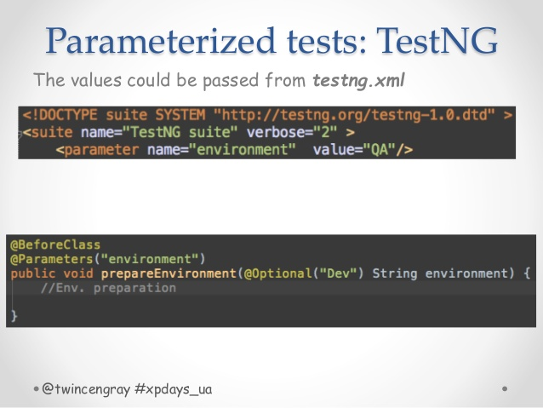

Slide 29
What is Cross browser testing?
Running test case in different browser like – Firefox, chrome, ie
Why?-
To check if my application run correctly in different browser

Slide 30
What is parallel browser testing?
Running test cases in different browser but will be run in the same time

Slide 31
Firefox download link
https://ftp.mozilla.org/pub/firefox/releases/46.0.1/win64/en-US/

Slide 32
How to do cross browser Code
@Parameter annotation(“browser”) and pass browser parameter
Method(String browserName)
If condition(browserName.equalignorecase(“forefox”))
{ write something
}

Slide 33
Cross browser & parallel browser testing
if(browserName.equalsIgnoreCase("Chrome")){
System.setProperty("webdriver.chrome.driver", "./Driver/chromedriver.exe");
driver = new ChromeDriver();}
else if (browserName.equalsIgnoreCase("IE")){
System.setProperty("webdriver.ie.driver", "./Driver/IEDriverServer.exe");
driver = new InternetExplorerDriver();}
driver.get("https://www.facebook.com/");
driver.manage().window().maximize();
driver.manage().timeouts().implicitlyWait(10,TimeUnit.SECONDS);
driver.manage().timeouts().pageLoadTimeout(60, TimeUnit.SECONDS);
driver.close();
driver.quit();
public class CrossbrowserTesting {
WebDriver driver;
@Test
@Parameters("browser")
public void getbrowser(String browserName) {
if(browserName.equalsIgnoreCase("FireFox")){
driver = new FirefoxDriver();
}

Slide 34
TestNG.xml for crossbrowser
<?xml version="1.0" encoding="UTF-8"?>
<!DOCTYPE suite SYSTEM "http://testng.org/testng-1.0.dtd">
<suite name="CrossBrowserTest" thread-count="3" parallel="tests" >
<test name="ChromeTest">
<parameter name="browser" value="Chrome" />
<parameter name="browser" value="Firefox" />
<parameter name="browser" value="IE" />
<classes>
<class name="com.usa.student.testng.CrossBrowserTest"> </class>
</classes>
</test>
</suite>

Slide 35
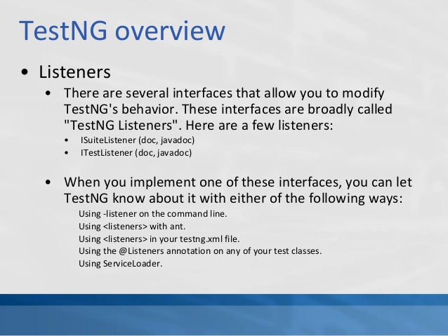

Slide 36
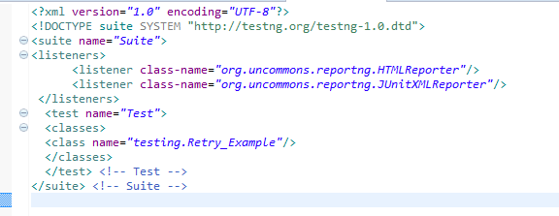

Slide 37
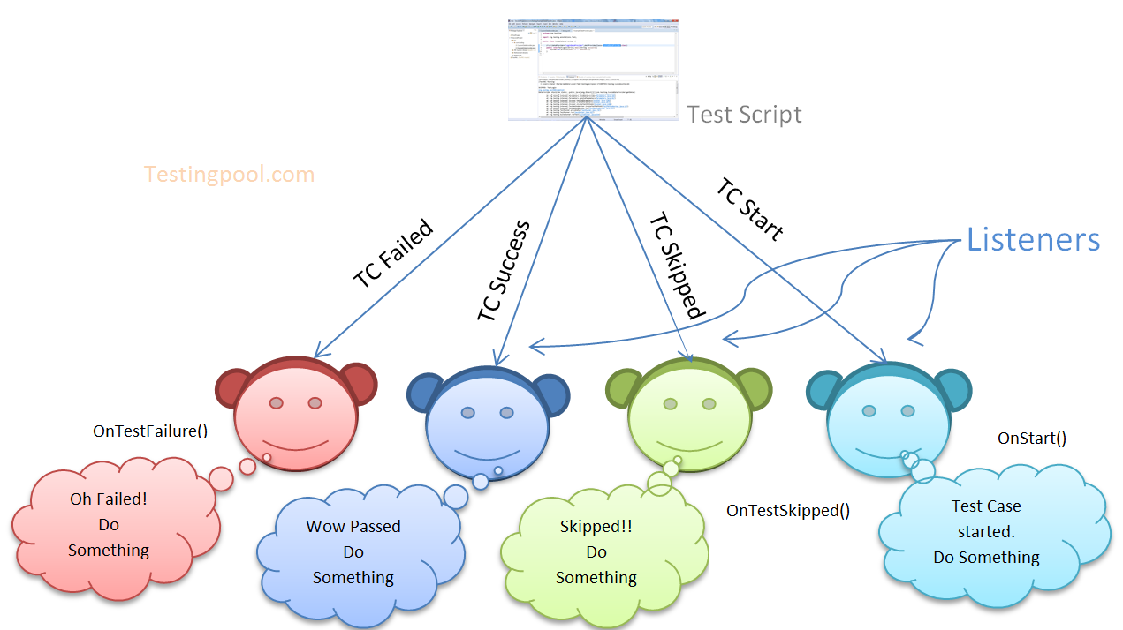

Slide 38
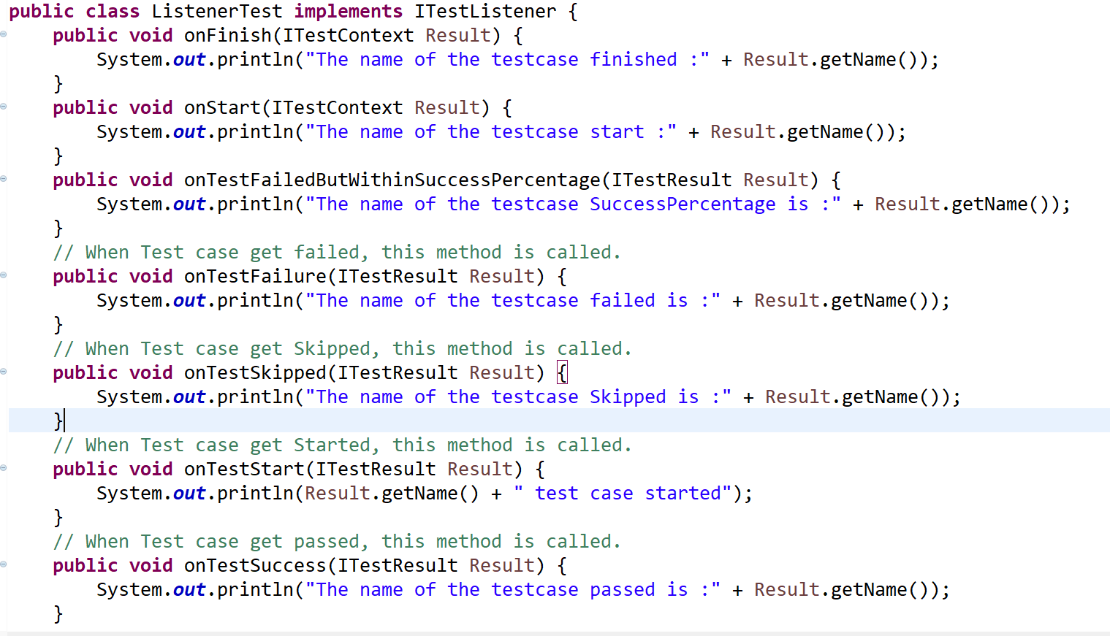

Slide 39
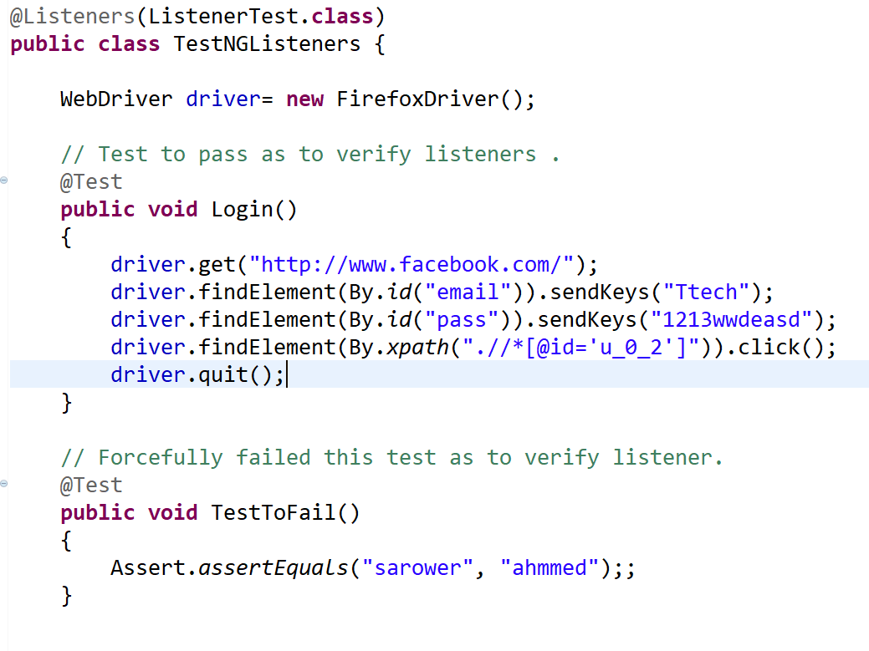

Slide 40
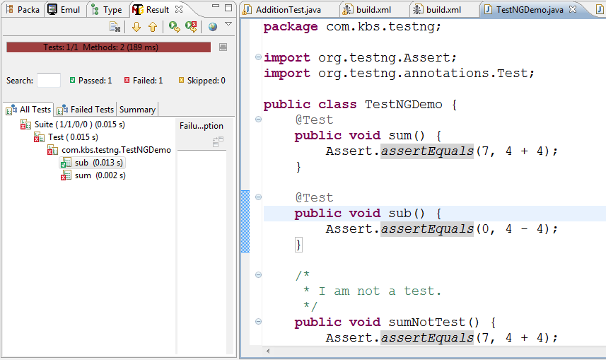

Slide 41
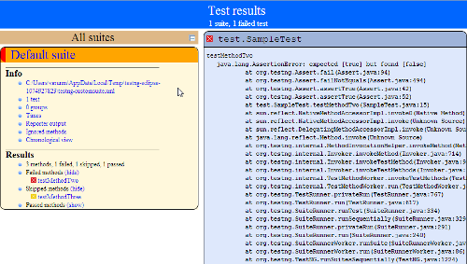

Slide 42
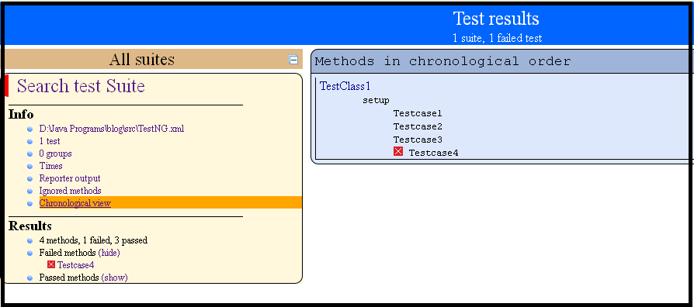

Slide 43
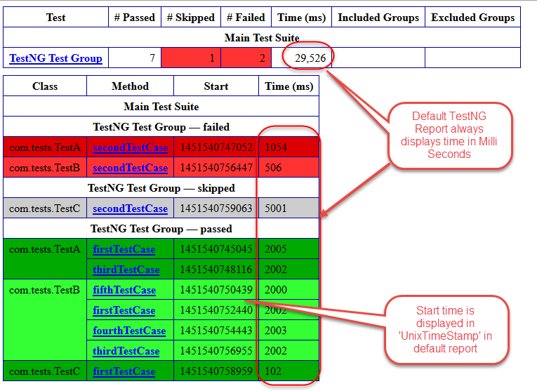

Slide 44
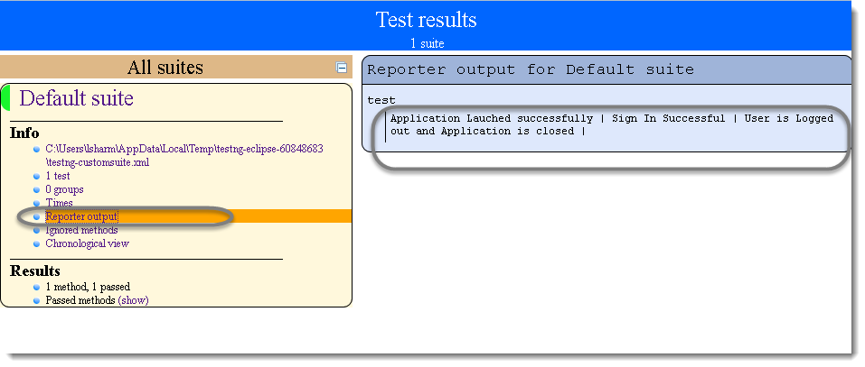

Slide 45
